Slide 1

6
Memory
CS/COE 0449 Introduction to Systems Software
Management
wilkie
(with content borrowed from Vinicius Petrucci and Jarrett Billingsley)
Spring 2019/2020

Slide 2
Our Story So Far
You Hear a Voice Whisper: “The Memory Layout is a Lie”

Slide 3
Reallocating our thoughts
Potential Layout
(32-bit addresses)
A program has several sections:
Code
Static data
Stack
Heap
Today, we take a deeper dive at how dynamic memory is allocated in the heap.
~ 0xFFFFFFFF
stack
currently unused but
available memory
heap
static data
code
~ 0x00000000

Slide 4
Reallocating our thoughts
Potential Layout
(32-bit addresses)
We have looked at malloc and calloc.
They stake out space in the heap and return an address.
Right now, we live in a nice ideal world.
No other programs are running.
We have access to all of the memory.
Muhahahaha!!
The OS is lying to our program.
This memory is… virtual... reality.
We will investigate this lie later in the course.
~ 0xFFFFFFFF
stack
currently unused but
available memory
heap
static data
code
~ 0x00000000

Slide 5
The World of Allocation
It is a puzzle without any optimal solution. Welcome to computers!

Slide 6
A heap of possibilities
Potential Layout
(32-bit addresses)
Stack access often does not deviate much.
We allocate a little bit at a time.
We allocate and free the memory VERY often.
Heap allocations have many access patterns that are possible.
You might allocate a lot at a time and keep it around for a long time. Or a short time.
You might allocate a lot of small things, instead.
Maybe you do a little bit of everything?
Often, such patterns are not easy to predict.
Do you get a big file as input? A small file?
~ 0xFFFFFFFF
stack
currently unused but
available memory
heap
static data
code
~ 0x00000000

Slide 7
A heaping helping of good luck
stack
Allocations could happen in a nice order.
When something is allocated, it can be allocated after everything else.
When freed, it makes room for new things.
IF ONLY.
I mean, it’s possible… but like…
the heap and stack are different things for a reason.
available memory
available memory
available memory
heap
static data
code
~ 0x00000000

Slide 8
Digital potholes… as annoying as real ones
stack
Small allocations interfere with large ones.
When small gaps interfere with allocation, this is called fragmentation.
available memory
available memory
available memory
available memory
available memory
available memory
malloc()
Ugh
Next
Allocation
free()
?
heap
if we had omniscience of future allocations, we could avoid this… but we can’t know ahead of time!
static data
code
Ugh
Ugh
~ 0x00000000

Slide 9
The worst case
stack
When you allocate a lot of small things…
Free every other one…
And then attempt to allocate a bigger thing…
Even though there is technically enough memory…
There is no continuous space.
Therefore, our naïve malloc will fail.
We have to come up with some strategy.
heap
malloc()
? ? ?
static data
code
~ 0x00000000

Slide 10
Moving is never easy
stack
Why not move things around??
A defragmentation process/algorithm
Moving around something in the heap is hard!
Any pointers referring to data within a block must be updated.
Finding these pointers automatically is effectively as difficult as garbage collection.
Because of this, moving blocks around is discouraged. (Easier to solve it another way.)
heap
malloc()
? ? ?
static data
code
~ 0x00000000

Slide 11
Moving is NEVER easy
stack
int* my_int
float* my_float
available memory
42
?????
3.14
-1.8e-6
When blocks move, pointers to anything within them must be updated.
This is hard to keep track of!
C does not check validity of pointers after free()
heap
static data
code
~ 0x00000000

Slide 12
Stressing it out
If we allocate a large array it will be allocated on the heap somewhere.
Other allocations can also happen, and they go “above” that array.
What happens when you need to append a 101st element to this array?
Uh oh!
You will need to allocate more space.
And then copy the array contents.
Free the old array.
How long does that take?
stack
available memory
int arr[200]
int arr[100]
old data: int arr[100]
fragmentation
heap
~ 0x00000000

Slide 13
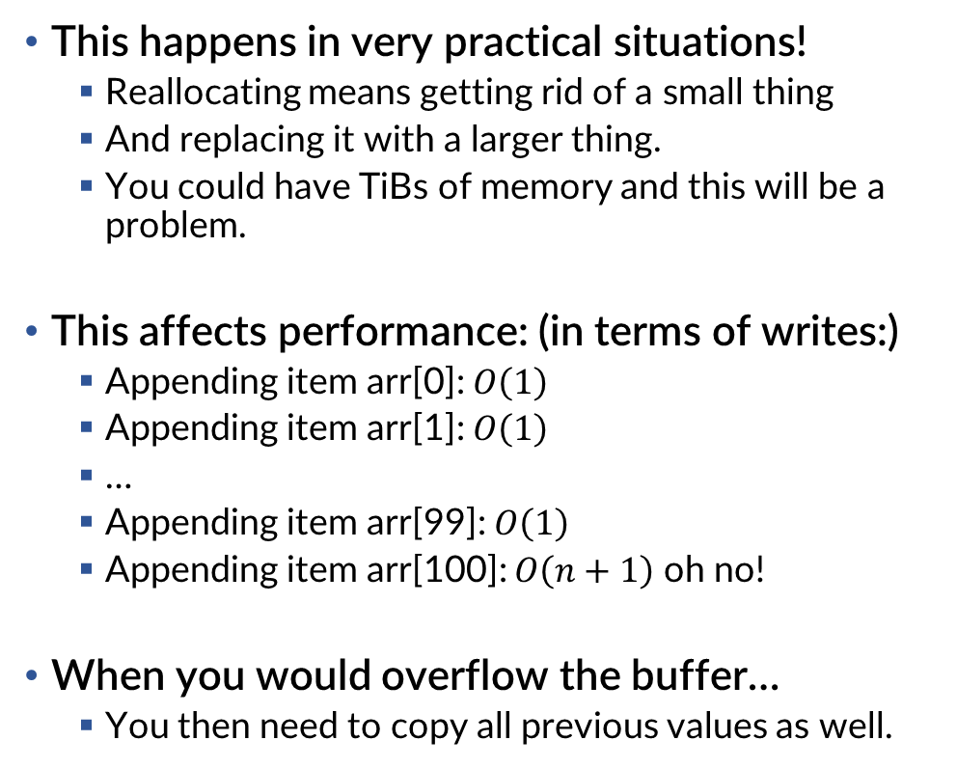
Stressing it out: Big Arrays
This happens in very practical situations!
Reallocating means getting rid of a small thing
And replacing it with a larger thing.
You could have TiBs of memory and this will be a problem.
This affects performance: (in terms of writes:)
Appending item arr[0]: $O\left(1\right)$
Appending item arr[1]: $O\left(1\right)$
…
Appending item arr[99]: $O\left(1\right)$
Appending item arr[100]: $O\left(n+1\right)$ oh no!
When you would overflow the buffer…
You then need to copy all previous values as well.
stack
available memory
int arr[100]
old data: int arr[100]
heap
~ 0x00000000

Slide 14
Stressing it out: Performance Consistency
Big arrays want to be continuous.
Ensuring continuous space is difficult when you do not know how much you will ultimately need.
This is exactly why linked lists exist!
Since a linked list allocates on every append.
Each append takes the same amount of time.
However, everything is a trade-off.
Dang it!!!
One cost is extra overhead for metadata.
Linked list traversal can stress memory caches.
It means traversing the array is slower.
However, we will mostly ignore this for now.
stack
available memory
int arr[100]
old data: int arr[100]
heap
~ 0x00000000

Slide 15
The Linked List
A story about trade-offs.

Slide 16

What is a linked list?
A linked list is a non-continuous data structure representing an ordered list.
Each item in the linked list is represented by metadata called a node.
This metadata indirectly refers to the actual data.
Furthermore, it indirectly refers to at least one other item in the list.
typedef struct _Node {
struct _Node* next;
char* data;
} Node;
Node
Node* next
“struct” required since Node is not technically
defined until after it is defined!
char* data

Slide 17
Keeping ahead of the list.
Creation of a list occurs when one allocates a single node and tracks it in a pointer. This is the head of our list (first element.)
Node* list = (Node*)malloc(sizeof(Node));
list->next = NULL; // NULL is our end-of-list marker
list->data = NULL; // Allocate/copy the data you want
Node
Node* next
Node* list
char* data

Slide 18
Adding some links to our chain
If we want to append an item, we can add a node anywhere!
void append(Node* tail, const char* value) {
Node* node = (Node*)malloc(sizeof(Node));
node->next = NULL; // The new end of our list
tail->next = node; // We attach this node to the old last node
node->data = (char*)malloc(strnlen(value, 100) + 1);
strncpy(node->data, value, 100);
}
Remember the
‘\0’ sentinel!
“tail”
“node”
Node* next
Node* next
Node* list
char* data
char* data

Slide 19
We can add them anywhere!!
Consider what happens if we update our append to take any Node:
void linkedListAppend(Node* curNode, const char* value) {
Node* node = (Node*)malloc(sizeof(Node));
node->next = curNode->next;
curNode->next = node;
node->data = (char*)malloc(strnlen(value, 100) + 1);
strncpy(node->data, value, 100);
}
“curNode”
“node”
Tail
Node* next
Node* next
Node* next
Node* list
char* data
char* data
char* data

Slide 20
We can add them anywhere!!
This function has very consistent performance (constant time):
The append always allocates the same amount.
It always copies the same amount.
Compare to a big array where you may have to copy the entire thing to append something new!
void linkedListAppend(Node* curNode, const char* value) {
Node* node = (Node*)malloc(sizeof(Node));
node->next = curNode->next;
curNode->next = node;
node->data = (char*)malloc(strnlen(value, 100) + 1);
strncpy(node->data, value, 100);
}

Slide 21
Traversal… on the other hand…
Accessing an array element is generally very simple.
arr[42] is the same as *(arr + 42) because its location is very well-known!
This is because array items are continuous in memory. Not true for linked lists!
Here is a function that performs the equivalent for linked lists:
Node* linkedListGet(Node* head, size_t index) {
Node* curNode = head;
while(curNode && index) {
index--;
curNode = curNode->next;
}
return curNode;
}
Q: How many times is memory accessed relative to the requested index?

Slide 22
Removing… on the other, other hand!
Node* linkedListDelete(Node* head, size_t index) {
Node* lastNode = NULL;
Node* curNode = head;
while(curNode && index) {
index--;
lastNode = curNode;
curNode = curNode->next;
}
if (!curNode)
return head;
if (!lastNode)
head = curNode->next; // New head is next item
else
lastNode->next = curNode->next; // Orphans item
free(curNode->data);
free(curNode);
return head;
}
One nice thing about linked lists is their flexibility to changing shape.
I used to be able to bend a lot better, too, when I was in my 20s. Alas.
Since we don’t have a way to go “backward”
We first find the node we want to delete (curNode)
Keeping track of the node of index – 1 (lastNode)
Rewire lastNode to cut out curNode.
Can’t find item at index.
We are deleting the head.
Returns new head (or old head if unchanged).

Slide 23
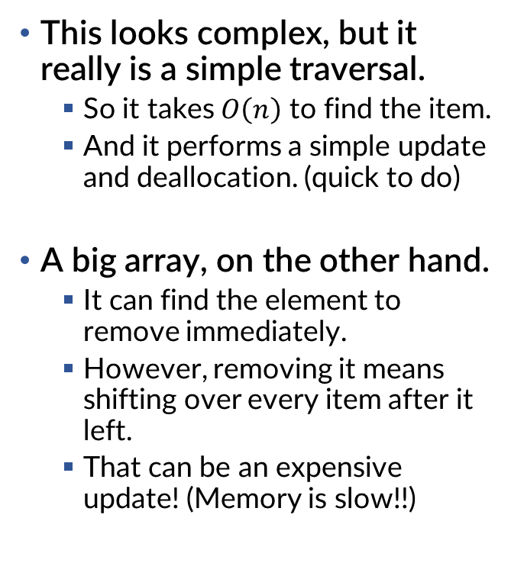
Removing… on the other, other hand!
Node* linkedListDelete(Node* head, size_t index) {
Node* lastNode = NULL;
Node* curNode = head;
while(curNode && index) {
index--;
lastNode = curNode;
curNode = curNode->next;
}
if (!curNode)
return head;
if (!lastNode)
head = curNode->next; // New head is next item
else
lastNode->next = curNode->next; // Orphans item
free(curNode->data);
free(curNode);
return head;
}
This looks complex, but it really is a simple traversal.
So it takes $O\left(n\right)$ to find the item.
And it performs a simple update and deallocation. (quick to do)
A big array, on the other hand.
It can find the element to remove immediately.
However, removing it means shifting over every item after it left.
That can be an expensive update! (Memory is slow!!)

Slide 24
On your own!
Think about the code you would need to do any of the following:
Delete/free the entire linked list.
Sort a linked list.
Append a linked list to an existing one.
Copy a subset of a linked list to a new list.
Often, operations can be abstracted in such a way that all of these can be written relatively simply.
Consider the performance of these operations compared to an Array.

Slide 25
Linked lists … link you … to the world!
Consider how much cleaner you can make certain operations if you tracked the previous node as well.
This is a doubly linked list.
This is typically “double-ended” as well: keeping track of both head and tail.
Node
Node
Node
Node* next
Node* next
Node* next
Node*
head
Node*
tail
Node* prev
Node* prev
Node* prev
char* data
char* data
char* data

Slide 26
Seeing the trees through the forest
A binary tree can be represented by the same nodes as a linked list.
In this case, you have a left and right child node instead of next and prev.
The operations are very different, though.
Node
Node* left
Node* right
Node
Node
char* data
Node* left
Node* left
Node* right
Node* root
Node* right
Node
Node* left
char* data
char* data
Node* right
char* data

Slide 27
De-Stressing it out: Linked Lists
We know big arrays want to be continuous.
However, ensuring continuous space is difficult when you do not know how much you will ultimately need.
Linked lists allocate very small chunks of metadata.
These chunks can be allocated easily on-demand.
And then deallocated without creating wide gaps.
This reduces fragmentation.
Deallocating always leaves a small amount of room.
It is always the exact amount needed to append!
However, it is all at the expense of complexity!
And traversal can be expensive (but we can find ways to deal with that.)
stack
available memory
some other data
heap
~ 0x00000000

Slide 28
Implementing Malloc
It really sounds like some kind of He-Man or She-Ra villain of the week.

Slide 29
The malloc essentials
stack
The malloc(size_t size) function does the following:
Allocates memory of at least size bytes.
Returns the address to that block of memory (or NULL on error)
Essentially, your program has a potentially large chunk of memory.
The malloc function tears off a piece of the chunk.
Also free must then allow that chunk to be reused.
The job of malloc is to do so in the “best” way to reduce fragmentation.
available memory
We want to avoid fragmentation
~ 0x00000000

Slide 30
Choosing where to allocate
Our first problem is, when malloc is called, where do we tear off a chunk?
We can do a few simple things:
First-Fit: start at lowest address, find first available section.
Fast, but small blocks clog up the works.
Next-fit: Do “First-Fit” but start where we last allocated.
Fast and spreads small blocks around a little better.
Best-Fit: laboriously look for the smallest available section to divide up.
Slow, but limits fragmentation.
stack
available memory
Last Allocated
malloc()
? ? ?
~ 0x00000000

Slide 31
Managing that metadata!
You have a whole section of memory to divide up.
You need to keep track of what is allocated and what is free.
One of the least complicated ways of doing so is to use… hmm…
A linked list! (or two!) We know how to do this!!
We can treat each allocated block (and each empty space) as a node in a linked list.
Allocating memory is just appending a node to our list.
The trick is to think about how we want to split up the nodes representing available memory.

Slide 32
Tracking memory: Our fresh new world.
Let’s orient our memory visually horizontally.
We have control over EVERY byte of it. We can place metadata ANYWHERE.
Every malloc is responsible for allocating a block of memory.
How, then, do we manage where things are allocated and where is empty space?
We can have “allocation” reduce to creating a new node in a linked list.
available memory
~ 0x00000000
AllocNode* allocList
We have the power to write data ANYWHERE! So where do linked list nodes go?

Slide 33
Linked lists are our friend, here
We will augment our normal doubly linked list to be useful for tracking the size of the block it represents. (an explicit list allocator)
Here, we will maintain a single linked lists of all allocated or free blocks.
The size field denotes how big the block is (how much is used/available.)
We need to know when a block represents allocated space or if it is free.
Hmm… we could use a single bit to denote that. Or… negativity!
The size is NEVER 0. In fact, malloc fails when requesting size of 0.
AllocNode
AllocNode* next
We can make other clever
space optimizations, but we will start with this.
AllocNode* prev
Signed! Negative number means a free block.
int size

Slide 34
Tracking memory: High level metadata
We can keep track of used/empty spaces cheaply by having linked list nodes at the beginning of them. The nodes track the size of the space.
Here we have an allocated block followed by a free and then allocated block.
The metadata for the linked list is just smashed into the block itself.
available memory
~ 0x00000000
AllocNode*
allocList
-size
-size
Q: What happens when we write over the block boundary?

Slide 35
Implementing malloc
To allocate some amount of space, we find a free block that is at least that size + metadata size. (Which one? Well, first-fit and friends apply!)
Then we will want to split that free block.
size
x
x
x
~ 0x00000000
available memory
AllocNode*
allocList

Slide 36
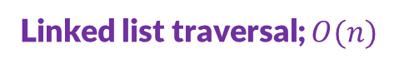
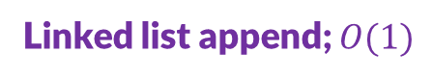
Implementing malloc
AllocNode* allocList;
void* malloc(size_t size) {
int wantedSize = -(int)(size + sizeof(AllocNode));
AllocNode* current = allocList;
while(current &&
current->size > wantedSize) {
current = current->next;
}
if (!current)
return NULL; // No free memory!
// Split the block
AllocNode* freeBlock = (AllocList*)(((char*)current) + size);
freeBlock->next = current->next;
freeBlock->size = current->size + (int)size + sizeof(AllocNode);
current->next = freeBlock;
current->size = size;
return (void*)(current + 1);
}
Allocating means finding a free block big enough.
Including the metadata size.
Then splitting it into a used block and a smaller free block.
This is incomplete. (Why?)
(you don’t always split)
Carefully negate size
Linked list traversal; $O(n)$
Linked list append; $O(1)$
Recall that we made size negative for a free block. current->size is negative.
Positive means non-free.
Think about it!
Q: This is first-fit. What should be added to implement next-fit? Best-fit?

Slide 37
Implementing free
When freeing the middle block, you will create empty space.
Consider allocations… it’s somewhat difficult to see the empty space.
You have “false fragmentation,” so you will want to merge adjacent free blocks.
available memory
~ 0x00000000
AllocNode*
allocList
node->prev
free(node)
node->next

Slide 38
Implementing free
So, when we free blocks, we look to the left. We look to the right.
We coalesce the newly free block with ANY adjacent free blocks.
First one…
Then the other. (And it is linked list node removal; a constant time operation!)
~ 0x00000000
available memory
AllocNode*
allocList
node->prev
free(node)
node->next

Slide 39

Implementing free
AllocNode* allocList;
void free(void* ptr) {
AllocNode* header = ((AllocNode*)ptr) - 1;
AllocNode* prev = header->prev;
AllocNode* next = header->next;
header->size = -header->size;
if (prev->size < 0) { // prev is free, coalesce
prev->size -= sizeof(AllocNode) + -header->size;
prev->next = header->next; header->next->prev = prev;
header = prev;
}
if (next->size < 0) { // next is free, coalesce
header->size -= sizeof(AllocNode) + -next->size;
header->next = next->next;
header->next->prev = header;
}
}
Finding the header metadata node is simple.
Look at our malloc’s return.
free is slightly less complex.
It does not have to search.
Where malloc splits nodes
free merges them.
Whenever a block is freed next to an existing one…
It should merge them!
Consider how much a doubly linked list helped.
Header is just before ptr
Resembles linked list delete; $O(1)$
However it subtracts from size (which makes reflect a larger space)
Q: Are any changes required here for best-fit?

Slide 40
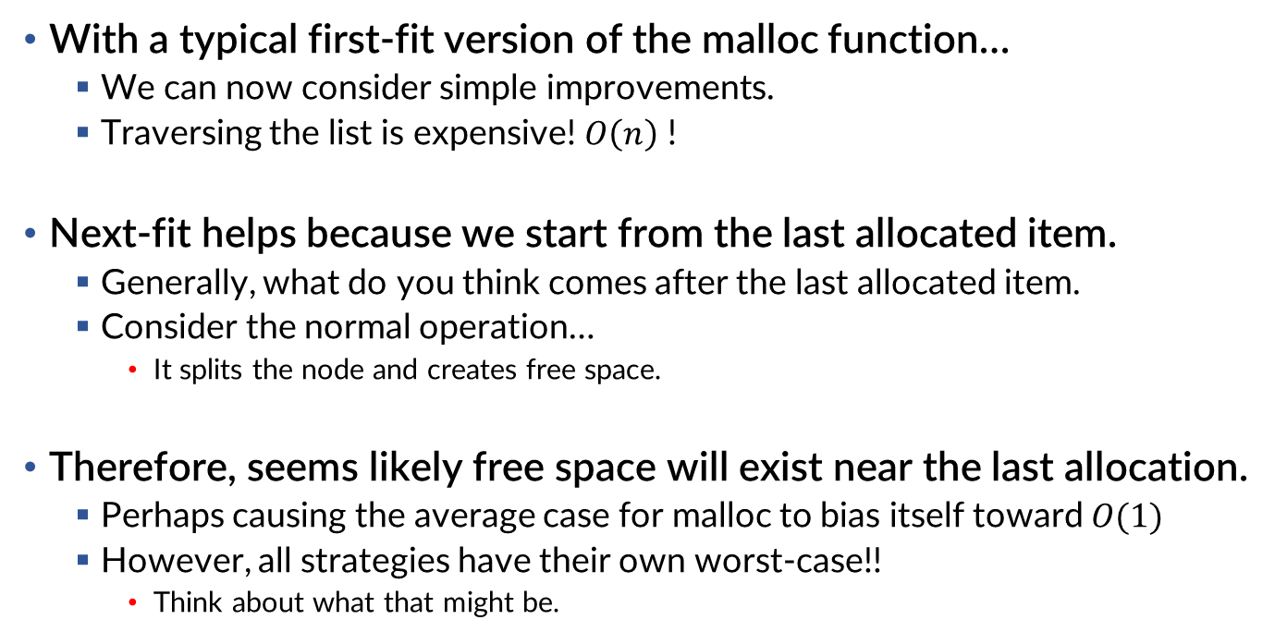
Thinking about next-fit
With a typical first-fit version of the malloc function…
We can now consider simple improvements.
Traversing the list is expensive! $O\left(n\right)$ !
Next-fit helps because we start from the last allocated item.
Generally, what do you think comes after the last allocated item.
Consider the normal operation…
It splits the node and creates free space.
Therefore, seems likely free space will exist near the last allocation.
Perhaps causing the average case for malloc to bias itself toward $O(1)$
However, all strategies have their own worst-case!!
Think about what that might be.

Slide 41
Thinking about best-fit
Best-fit, on the other hand, is not about avoiding traversal.
Instead, we focus on fragmentation.
Allocating anywhere means worst-case behavior splits nodes poorly.
If we find a PERFECT fit, we remove fragmentation.
Traversal is still bad… and we brute force the search...
But, hey, solve one problem, cause another. That’s systems!
Fragmentation may indeed be a major issue on small memory systems.
What is the best of both worlds? Next-fit + Best-fit?
Hmm.
Works best if you keep large areas open.

Slide 42
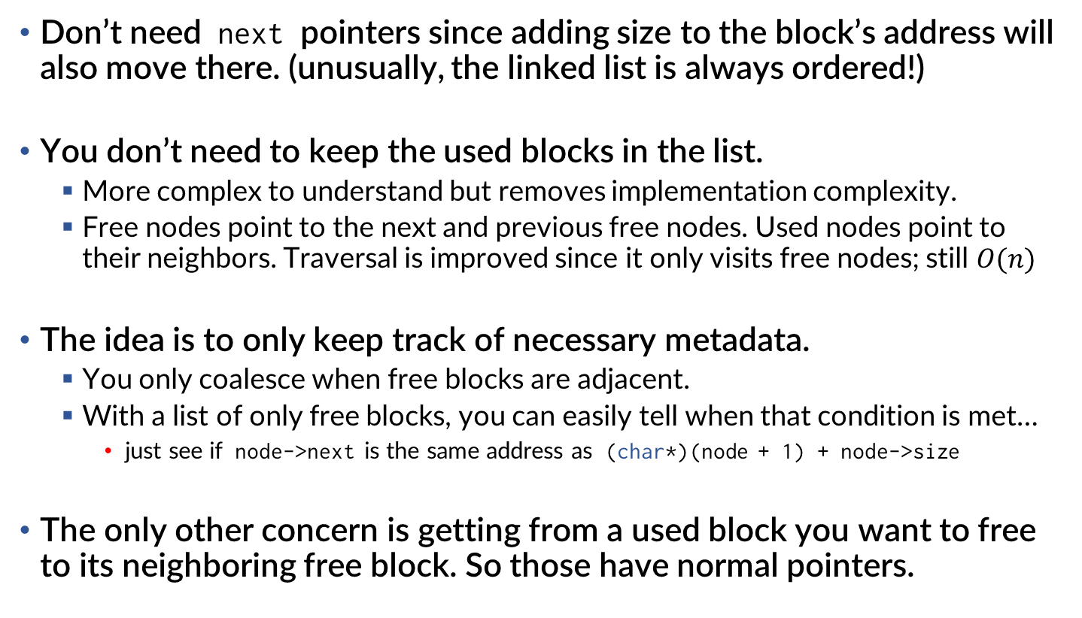
Other thoughts
Don’t need next pointers since adding size to the block’s address will also move there. (unusually, the linked list is always ordered!)
You don’t need to keep the used blocks in the list.
More complex to understand but removes implementation complexity.
Free nodes point to the next and previous free nodes. Used nodes point to their neighbors. Traversal is improved since it only visits free nodes; still $O(n)$
The idea is to only keep track of necessary metadata.
You only coalesce when free blocks are adjacent.
With a list of only free blocks, you can easily tell when that condition is met…
just see if node->next is the same address as (char*)(node + 1) + node->size
The only other concern is getting from a used block you want to free to its neighboring free block. So those have normal pointers.

Slide 43
Explicit free lists: giving you VIP access
When you allocate, you go through the free list.
You don’t care about allocated nodes.
When you free, you only care about coalescing neighbors.
available memory
~ 0x00000000
AllocNode*
freeList
Q: Do free nodes need a prev pointer?

Slide 44
Quick notes on boundary tags and fancy tricks
Boundary tags are when you put the size as the first and last item in the block to avoid next and previous pointers.
This is an implicit list since there are no pointers.
You navigate next/previous by adding/subtracting the size.
Although, once again, free nodes do not need to go backward.
They do not necessarily improve upon explicit lists.

Slide 45
Trees are your buddy
Recall that we easily took the ideas around linked lists and made binary trees.
You can manage memory with a binary tree as well.
This is called a buddy allocator.
size
size
size

Slide 46
Divide and conquer
Buddy allocators divide memory into halves that are powers of two.
Can cause internal fragmentation
T
The total memory, T , is a power of two.
Each split is, then, also a power of two.
T/2
T/4
Allocation is not a power of two: internal fragmentation
<
T/8
0x00000000
T (total size)

Slide 47
Allocating with trees
Assuming T is 512, and we allocate 242MiB: malloc(242*1024*1024)
We travel left until we find a block that fits.
512
We travel back up when we can’t go further left and go right.
256
When we find a unsplit node that fits, we allocate there.
128
60 MiB
242 MiB
0x00000000
T (total size)

Slide 48
Burying the hatchet: Chopping the trees
Let’s allocate 64MiB. So nice, we will allocate it twice.
Again a depth-first search to find the first unsplit node that fits us.
512
This node is fine! Allocate that!
Do it again!
256
When we find a unsplit node that is too big, we split in half and keep going.
128
128
60 MiB
64 MiB
64 MiB
242 MiB
0x00000000
T (total size)

Slide 49
Coalescing friendships (animated)
Coalescing happens because every block has a buddy!
When both sides of a split node are free, coalesce them!
512
If this keeps happening, it will coalesce larger spaces.
256
Repeating as much as necessary.
128
128
60 MiB
64 MiB
64 MiB
242 MiB
x
x
x
0x00000000
T (total size)

Slide 50
Thinking like an arborist (but only if you are feeling listless)
How does a tree-based allocation system deal with fragmentation?
What are some immediate drawbacks from using a tree scheme?
512
256
128
60 MiB
242 MiB
0x00000000
T (total size)
available memory
Can you imagine a possibility of using a hybrid approach?
0x00000000

Slide 51
Lies and Damned Lies!
Does your program actually own all of memory?
On modern systems, absolutely heckin not.
Your program still has to request memory allocations from the OS.
Generally, malloc takes on this responsibility behind the scenes.
In Linux, you request pages in the normal heap in LIFO order with sbrk.
Or, you request specific virtual memory pages with mmap.
What is a segmentation fault.
Segments are the “code”, “data”, “heap” separation. You fault by doing something the segment does not allow. (write to read-only memory)
A historic misnomer since we actually have paging, not segmented memory.
What is a “page”? Virtual memory??
It replaced segments and is part of the much grander lie about sharing memory with multiple applications at the same time. More on this later!

Slide 52
I want to know MORE
If you find this topic interesting, it is a WIDE area of research.
Malloc is generally more complex or specialized these days than the options here.
Or some kind of hybrid, as the need arises.
The Linux kernel makes use of a Slab Allocator
https://en.wikipedia.org/wiki/Slab_allocation
Modern C (glibc) uses a hybrid malloc:
https://www.gnu.org/software/libc/manual/html_node/The-GNU-Allocator.html
Professor Knuth has written about several classic algorithms.
Buddy Allocation comes from the 60s. Groovy.

